Slide 1
Shell Bootcamp 2024 SAP-ERP TECHNICAL 3 Reflections for Week 3 (09-Sep-2024 – 13-Sep-2024)
Hitesh
Date : 13-Sep-2024

Slide 2

About Me
Communication is the solvent of all problems and is the foundation for personal development.

Slide 3

My learnings from this week!

Slide 4
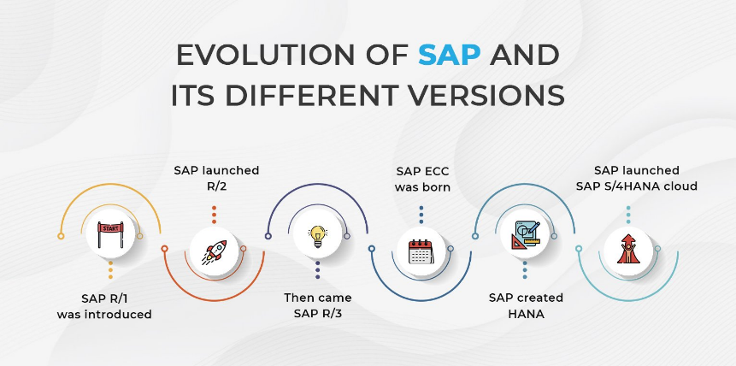
Learning 1 | My takeaways
SAP and its Evolution
Key Learning: SAP, which stands for Systems, Applications, and Products in Data Processing, has evolved significantly over time. It started with SAP R/1 (a single-tier architecture), progressed to SAP R/3 (three-tier client-server architecture), and culminated in SAP S/4HANA, which integrates in-memory computing for real-time data processing and analytics.
Key Takeaway: The shift from traditional, slow systems to real-time analytics in SAP S/4HANA is groundbreaking for industries requiring fast decision-making and live updates. SAP's real-time capabilities help improve business operations with data-driven decisions.
How I see it implemented in the Energy Sector: In the energy sector, real-time analytics from SAP S/4HANA can optimize energy distribution and consumption. Real-time data can help energy companies monitor grid performance, manage resources, and predict energy demands, thus improving operational efficiency and reducing costs.

Slide 5
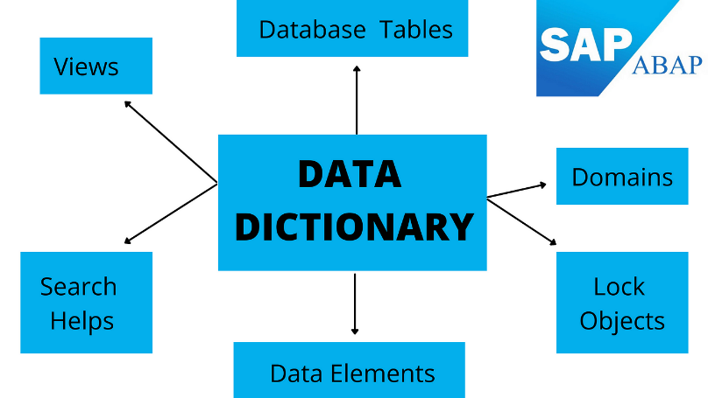
Learning 2 | My takeaways
ABAP and Modular Programming
Key Learning: ABAP (Advanced Business Application Programming) is the core language used in SAP for developing applications. Key concepts include creating custom tables, modularization techniques (e.g., function modules, subroutines), and data management using Open SQL queries.
Key Takeaway: ABAP allows developers to structure code in a modular way, which improves code reusability and efficiency in SAP systems. It also enables data manipulation directly within the SAP environment through data dictionary and SQL integrations.
How I see it implemented in the Energy Sector: In the energy sector, ABAP modular programming could be used for custom applications to manage energy production workflows, asset maintenance schedules, and energy billing systems. These systems could be tailored to meet the specific needs of energy production and distribution, enhancing their flexibility and scalability.

Slide 6
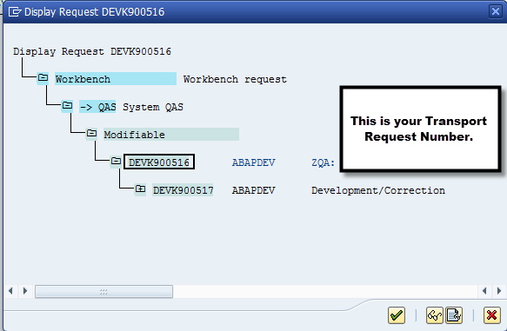
Learning 3 | My takeaways
Transport Requests and Transaction Codes (T-codes)
Key Learning: Transport requests are vital in SAP for moving developments (like custom tables, reports, and programs) from one environment (development) to another (production). In addition, Transaction Codes (T-codes) are shortcuts in SAP to access specific functions directly, bypassing the need to navigate through multiple menus. For instance, SE38 is used for managing programs in ABAP, and SE93 is used for creating custom T-codes.
Key Takeaway: Effective management of Transport Requests ensures smooth transitions of system updates and new functionalities. T-codes enhance user productivity by offering direct access to specific tasks. Together, they ensure efficient development, testing, and deployment processes in SAP.
How I see it implemented in the Energy Sector: In the energy sector, transport requests ensure seamless updates to mission-critical applications like automated energy billing systems or equipment maintenance tracking. Using T-codes like SE93, energy companies can create custom transaction codes for specific business functions, such as meter readings, reducing the need for manual navigation and streamlining operations.

Slide 7

Relevance of learnings for my organization

Slide 8
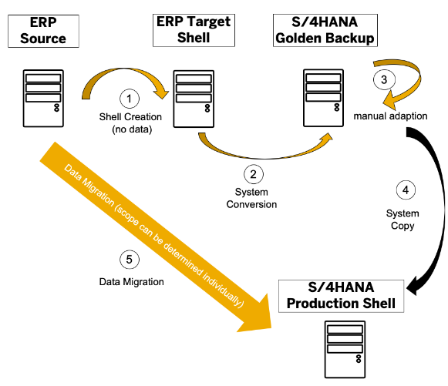
Learning 1 | Relevance for Shell
SAP and its Evolution
How I feel Shell implements this learning: Shell uses SAP S/4HANA to streamline its business operations, especially for real-time data processing in areas like supply chain management, finance, and procurement. The implementation of SAP's latest technologies helps Shell optimize processes and make data-driven decisions quickly.
How I feel Shell benefits from this learning: By leveraging SAP S/4HANA, Shell can monitor and manage its resources globally in real time, improving asset management and supply chain efficiencies. This system allows for better prediction of demand, enhanced energy production planning, and cost reduction through optimized operations.

Slide 9

Learning 2 | Relevance for Shell
ABAP and Modular Programming
How I feel Shell implements this learning: Shell likely utilizes ABAP for developing custom applications to meet its unique business needs. By using ABAP’s modular programming techniques, Shell can customize SAP modules to create tailored solutions for energy management, resource planning, and financial tracking.
How I feel Shell benefits from this learning: The modular approach of ABAP allows Shell to adapt SAP to fit its specific energy sector requirements. This means quicker implementations, improved system flexibility, and more efficient management of energy assets, reducing operational bottlenecks and ensuring systems can scale with business needs.

Slide 10

Learning 3 | Relevance for Shell
Transport Requests and Transaction Codes (T-codes)
How I feel Shell implements this learning: Shell likely uses Transport Requests (TR) to manage changes across its multiple SAP systems, ensuring that new developments are properly tested before going live. Transaction Codes (T-codes) allow Shell’s employees to access SAP functionalities quickly and efficiently, simplifying complex processes like asset management, billing, and reporting.
How I feel Shell benefits from this learning: By utilizing Transport Requests, Shell can maintain system stability while rolling out updates or new functionalities across its global SAP landscape. T-codes improve operational efficiency by enabling employees to perform tasks quickly, reducing downtime and increasing productivity. This ensures smoother workflows, especially in critical operations like real-time monitoring of energy production and distribution.

Slide 11

Challenges in implementing learning

Slide 12
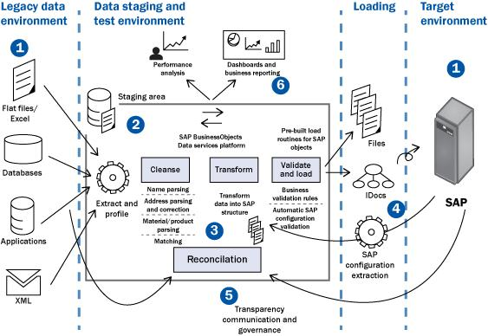
Challenge faced while implementing Learning 1
SAP and its Evolution
Challenge Faced: Implementing SAP S/4HANA across a large, global organization like Shell can be challenging due to the complexity of migrating from legacy systems to a real-time, in-memory platform. Ensuring data accuracy and minimizing downtime during migration is critical.
Plan to Overcome: Shell can implement a phased rollout strategy to gradually transition systems to SAP S/4HANA, starting with less critical operations. Extensive testing, data validation, and robust change management procedures would help reduce risks and ensure a smoother transition while keeping stakeholders informed.

Slide 13
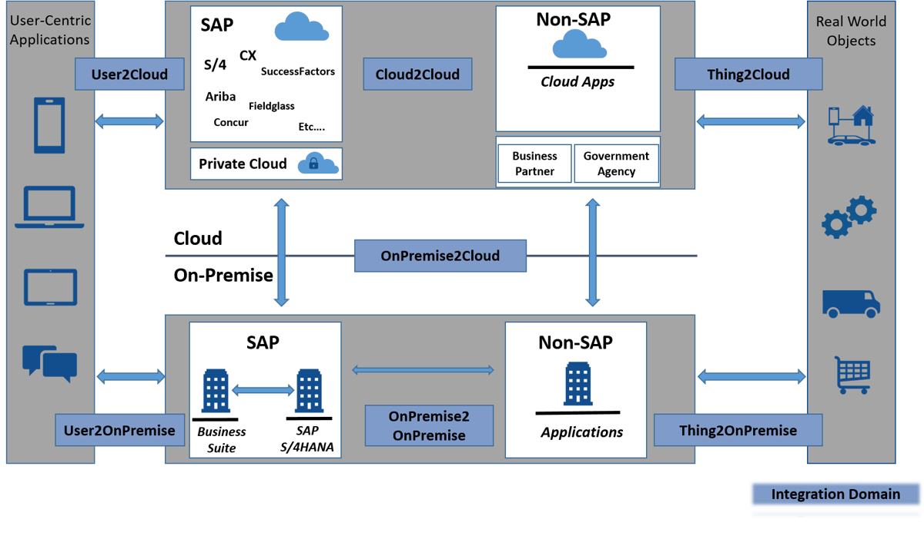
Challenge faced while implementing Learning 2
ABAP and Modular Programming
Challenge Faced: One of the key challenges in utilizing ABAP modular programming is ensuring the custom applications are well-integrated with standard SAP modules without affecting performance or creating dependency issues, especially when managing large datasets in energy operations.
Plan to Overcome: To overcome this, Shell can establish strict coding guidelines for ABAP development, enforce code reviews, and optimize database access using efficient SQL queries. Leveraging performance testing tools and monitoring system load can also ensure that the custom modules perform efficiently without affecting the broader SAP ecosystem.

Slide 14

Challenge faced while implementing Learning 3
Transport Requests and Transaction Codes (T-codes)
Challenge Faced: Managing Transport Requests (TR) can become complex, especially when multiple developers are working on different parts of the system. Conflicting or incomplete transports can result in errors or disruptions in the live environment. Additionally, improper use of T-codes can lead to inconsistent processes if they are not standardized across the organization.
Plan to Overcome: Shell can mitigate these risks by using centralized transport management tools and procedures, ensuring all transports are thoroughly tested before being moved to production. Establishing a process for approving and validating T-codes will also ensure they are used consistently across teams. Regular training and clear documentation of best practices for TRs and T-codes will help maintain system integrity and operational efficiency.

Slide 15

Action Plan

Slide 16
My Action Plan for this Week
Actions
Timeline
Status
Review and practice SAP S/4HANA migration strategies, including data validation and phased rollout approaches.
Develop small ABAP programs utilizing modularization techniques (subroutines, function modules) and optimize SQL queries for performance.
Create and test Transport Requests in a sandbox environment, ensuring proper use of T-codes and transport management processes.
Research and document best practices for managing T-codes and TRs, including conflict resolution and approval workflows.
3 days
2 days
2 days
1 day
Completed
Completed
Completed
Completed

Slide 17

Learning is also Fun!

Slide 18

Learning is also Fun!
Activity:
We had interactive jam sessions and engaging story sessions where team members shared insights about their specialties. These sessions gave me a deeper understanding of my colleagues' expertise while building a collaborative learning environment.
A big relief came when we transitioned to hands-on practical sessions after several long days of theory. The practical work allowed us to apply what we had learned, making the experience more dynamic and engaging.
Additional Fun Activities:
After the sessions, we had a team lunch, which turned into a fun pizza party! It was a great opportunity to bond over food and laughter, creating a relaxed and friendly atmosphere that made learning more enjoyable and helped build stronger connections with the team.

Slide 19

Summary
Quick Summary
This week, we delved into SAP's evolution, ABAP programming, and transport management. We explored the transition from SAP R/1 to S/4HANA, applied ABAP modular programming techniques, and learned about managing transport requests and transaction codes. Hands-on practical sessions provided relief and engagement after extensive theory, and we wrapped up with a fun pizza party.
Importance of Topics for Upcoming Week
Next week, it's essential to apply our understanding of SAP S/4HANA in real-world scenarios, enhance our ABAP skills by developing custom applications, and effectively manage transport requests and T-codes to ensure system stability and efficiency.
Connectivity of Topics from Current Week
Understanding SAP's evolution sets the stage for leveraging ABAP in a modern environment, while effective transport management and T-codes ensure that custom developments are smoothly integrated. This cohesive approach supports both operational efficiency and system customization.

Slide 20
Thank You

